Slide 1


PROB-PLOT
Visualize & Calculate Probability Distributions
A Streamlit app for Interactive Simulation & Analysis
Name: Vaibhavi Deo
Roll No: A011

Slide 2


KEY FEATURES
Visualize Probability Distributions: Explore various distributions like Normal, Uniform, Exponential, Gamma, Beta, Student's t, and Chi-Squared.
Interactive Parameters: Adjust distribution parameters to observe changes in shape and behavior.
Calculate Probabilities: Compute probabilities for specific intervals or tail regions.

Slide 3
FUNCTIONS
For this web-based application,the python library - streamlit is used.
st.title() -
Sets the title of the app.
st.selectbox() -
Creates a dropdown menu for selecting options.
st.number_input() -
Creates input fields for numerical values.
st.button() -
Creates a button to trigger actions when clicked
st.pyplot() -
Displays a Matplotlib plot in the Streamlit app.
st.write() -
Displays text or other objects in the Streamlit app.
Along with these, the numpy, scipy, and matplotlib libraries are used to perform numerical calculations, statistical analysis, and create visualizations, respectively.

Slide 4
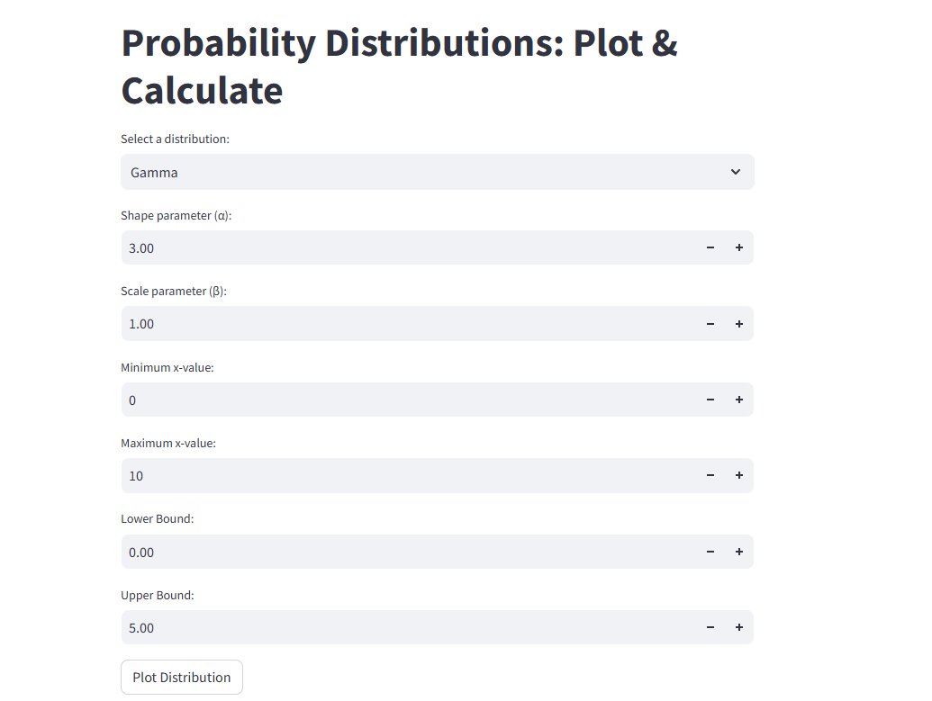
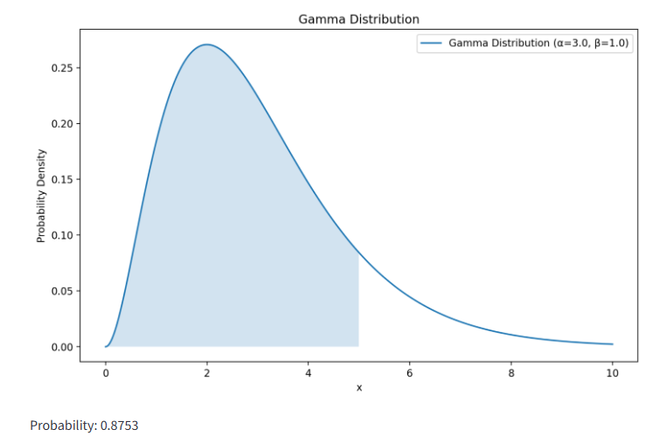
UI

Slide 5
BENEFITS
Educational: A valuable tool for learning about probability distributions and their behavior.
Research: Useful for data analysis, modeling, and hypothesis testing.
Decision Making: Aids in decision-making by providing insights into likelihoods.
Interactive Exploration: Allows for easy experimentation and understanding of distribution properties.

Slide 6
THANK YOU

